Slide 1
Master Thesis: Hand Gesture Recognition with Time-of-Flight Camera for Smart Glasses
Ying-Hong Lu
Advisor: Chiou-Shann Fuh, Ph.D
National Taiwan University

Slide 2
1. Introduction

Slide 3
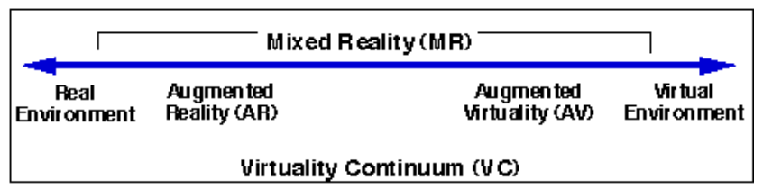
1.1 The Concept of Augmented Reality (AR) and Metaverse
AR is a subset of Mixed Reality (MR), which is a “virtuality continuum”
Milgram & Kishino, 1994

Slide 4
1.1 The Concept of Augmented Reality (AR) and Metaverse
The six classes of Mixed Reality (Milgram & Kishino, 1994):
Monitor-based displays, real-world scene and computer generated scenes are digitally overlaid and displayed.
Displays as in Class 1, but head-mounted, a.k.a., Head-Mounted Displays (HMD).
HMD’s equipped with see-through capability.
Similar to Class 3, but uses video. The displayed world should correspond orthoscopically with the immediate outside real world.
Completed graphic display environments, to which video “reality” is added.
Completely graphic but partially immersive environment where real physical objects in the user’s environment play a role in the scene.

Slide 5
1.2 Display & Movement Tracking
6-Degrees of Freedom (6-DOF)
Three translations: movement along the X, Y, Z axes
Three rotations: roll, pitch, and yaw
Tracking subjects:
Head orientation: typically an Inertial Measurement Unit (IMU) is used
User position
Pedestrian dead reckoning realized with IMU.
Image-based camera localization.
Eye tracking:
Estimates the point of gaze based on pupil or corneal reflection tracking.

Slide 6
1.3 Interacting with Smart Glasses
3 classes of interactive approaches (Lee & Hui, 2018):
Handheld
Input with handheld controllers, such as a smartphone.
Touch
Non-handheld touch input.
Touchless
Non-handheld, non-touch input.
Examples: mid-air hand gesture, head and body movements, gaze, voice.

Slide 7
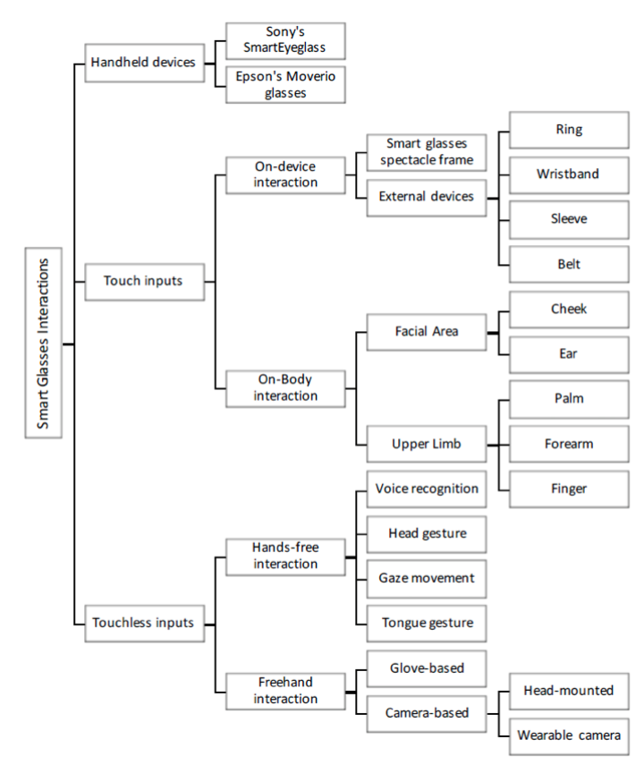
Lee & Hui, 2018

Slide 8
1.3 Interacting with Smart Glasses
3 classes of interactive approaches (Lee & Hui, 2018):
Handheld
Input with handheld controllers, such as a smartphone.
Touch
Non-handheld touch input.
Touchless
Non-handheld, non-touch input.
Examples: mid-air hand gesture, head and body movements, gaze, voice.
Lee & Hui, 2018

Slide 9
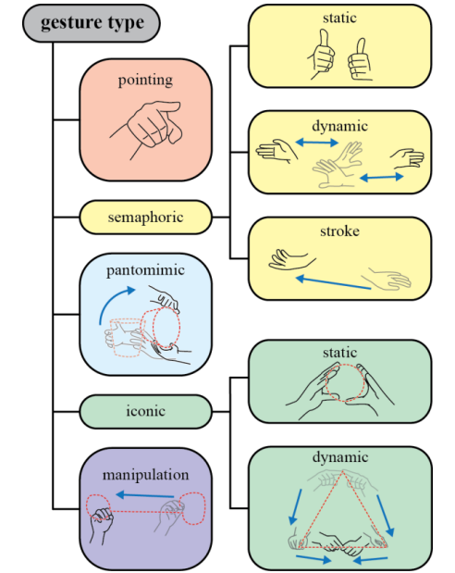
1.4 Mid-Air Hand Gestures
Approaches to design a gesture language for user interaction:
The User-Defined Interfaces (UDI) methodology
Design a language formed to avoid conflicts, but also ergonomic and high-bandwidth
Aigner et al., methodology similar to UDI but improved the ambiguity
Target gesture effects: select, release, accept, refuse, remove, cancel, navigate, identify, translate, and rotate.
Gesture types: pointing, semaphoric, pantomimic, iconic, and manipulation.

Slide 10
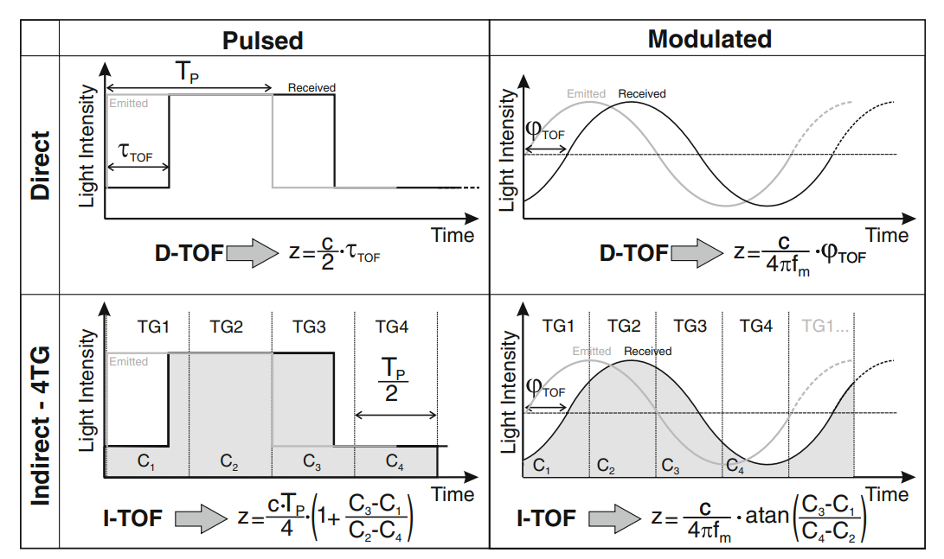
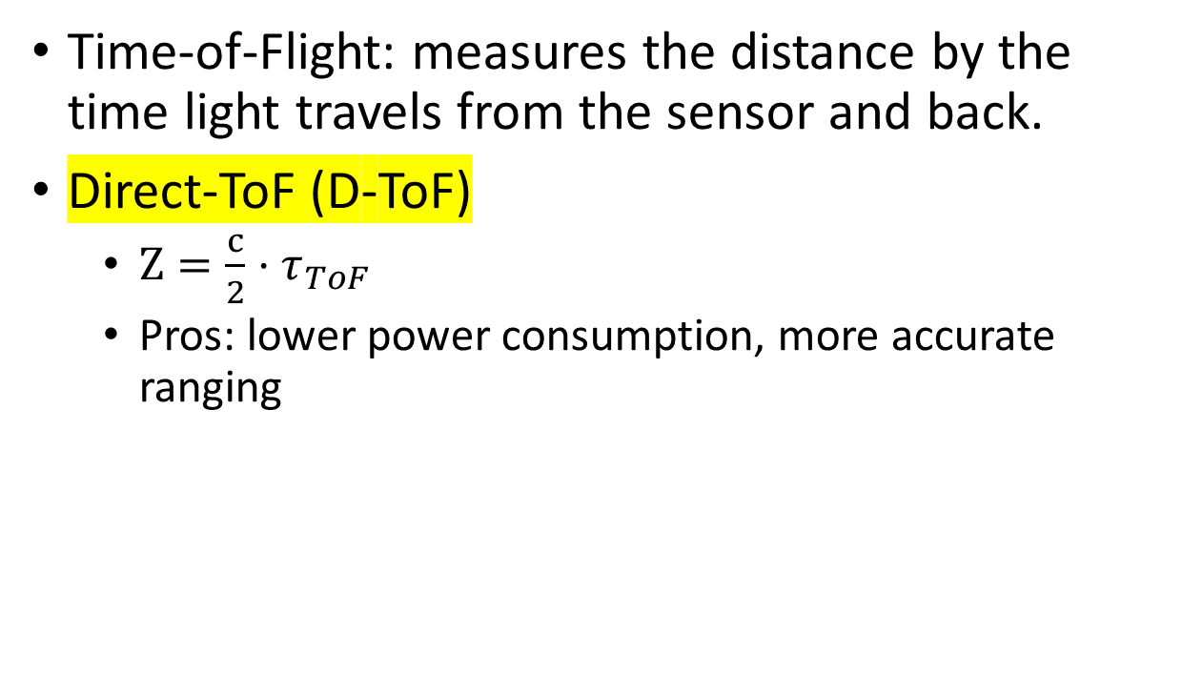
1.5 The Time-of-Flight (ToF) Sensor
Time-of-Flight: measures the distance by the time light travels from the sensor and back.
Direct-ToF (D-ToF)
$Z=\frac{c}{2}⋅τ_{ToF}$
Pros: lower power consumption, more accurate ranging

Slide 11
2. Problem Description

Slide 12
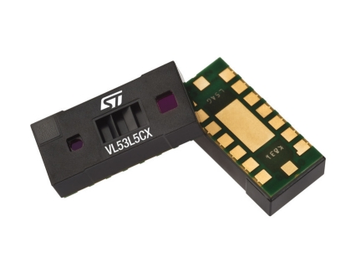
2.1 The Low-Resolution Depth Sensor
Resolution: 8 x 8, 64 pixels
Range: from 5mm up to 400 cm
FoV: 64 degrees diagonally
Refresh rate: 15 FPS at 8 x 8 pixels
Pros of using ToF:
Eliminate background noise
Detect motions perpendicular to the image plane
Sensor
Light Source

Slide 13
2.2 Gesture Recognition
Limitation 1: low pixel count
Eliminates static signs and finger gestures.
We select gestures with large area of motion, such as swiping.
Limitation 2: small FoV
High sensing area in front of the user’s forehead.
We select gestures with less arm movement.
We add visual cues to let the user be aware of their hand positions.
Limitation 3: sensor movement
Head orientation changes affect the sensing area.
We select gestures that are more interactive, such as hand tracking.

Slide 14
3. Methodology

Slide 15
3.1 Gesture Set I: Swipe + Push/Pull
6 gestures:
4 swipe directions parallel to the sensor plane
2 motions perpendicular to the sensor planes

Slide 16
3.1.1 Swipe
Direction: up, down, left, and right
Mimic the arrow keys, easier integration to existing systems.
Enter the frame / Start moving → Move → Leave frame / Stop
The frame differencing method:
ToF sensor has good background rejection, moving background doesn’t affect the result
Simple method, requires less computation, runs on Micro Controller Unit (MCU)
Convert to binary image, pixel value indicates whether a hand is detected.

Slide 17
3.1.1 Swipe
Detect the presence of a hand

Slide 18
3.1.1 Swipe
Detect the presence of a hand
Binarize the image

Slide 19
3.1.1 Swipe
Detect the presence of a hand
Binarize the image
Calculate difference image
Leading edge: 1
Trailing edge: -1
Surrounded region: hand
Slope is the direction

Slide 20
3.1.1 Swipe
1
4
7
4
1
4
16
26
16
4
Detect the presence of a hand
Binarize the image
Calculate difference image
Blur
Not every row has both 1 and -1
5 by 5 Gaussian blur kernel
1/273
7
26
41
26
7
4
16
26
16
4
1
4
7
4
1

Slide 21
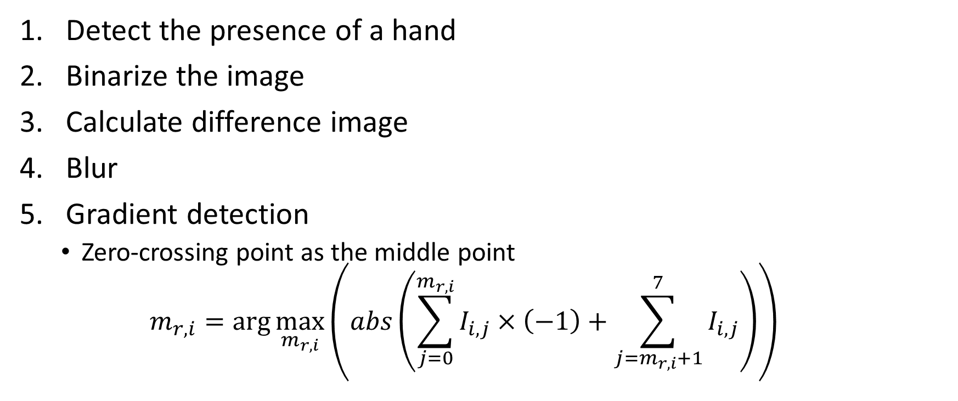
3.1.1 Swipe
Detect the presence of a hand
Binarize the image
Calculate difference image
Blur
Gradient detection
Zero-crossing point as the middle point
$$m_{r,i}=\arg{\max_{m_{r,i}}\left(abs\left(\sum_{j=0}^{m_{r,i}}{I_{i, j}}×\left(−1\right)+\sum_{j=m_{r,i}+1}^{7}{I_{i,j}}\right)\right)}$$

Slide 22
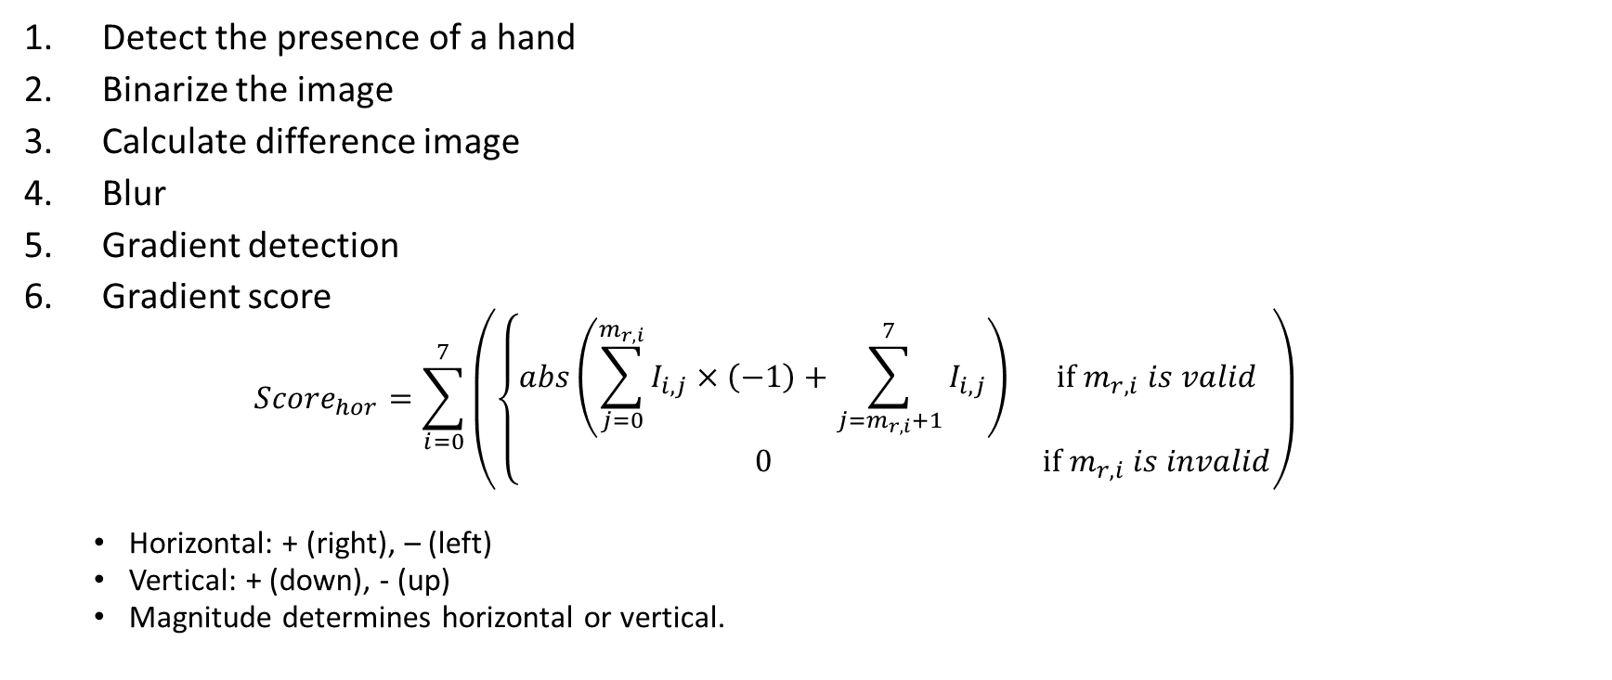
3.1.1 Swipe
Detect the presence of a hand
Binarize the image
Calculate difference image
Blur
Gradient detection
Gradient score
$${Score}_{hor}=\sum_{i=0}^{7}{\left(\left\{\begin{matrix}abs\left(\sum_{j=0}^{m_{r,i}}{I_{i, j}}×\left(−1\right)+\sum_{j=m_{r,i}+1}^{7}{I_{i,j}}\right) & if m_{r,i} is valid \\ 0 & if m_{r,i} is invalid\end{matrix}\right.\right)}$$
Horizontal: + (right), – (left)
Vertical: + (down), - (up)
Magnitude determines horizontal or vertical.

Slide 23
3.1.2 Push/Pull
Push/Pull
Perpendicular to the sensor plane, we can use the range data.
Triggered by an invisible wall.
Parameters:
Sensing range
Threshold of pixels in sensing range
Distance of the invisible wall from the sensor
Number of pixels to trigger a gesture
Minimum time between push or pull gesture events

Slide 24
3.1.2 Push/Pull
Push/Pull
Three stages
Ready stage
Trigger stage
Sleep stage

Slide 25
3.2 Gesture Set II: Hand Speed
Push gesture from Gesture Set 1, with added speed detection when the hand passes through the invisible wall
Bimanual detection is possible by splitting the detecting area
Problem: forearm and low FPS causes inaccuracy

Slide 26
3.3 Gesture Set III: Hand Tracking
Use their hand as a cursor, easier integration into existing User Interfaces (UIs)
Low resolution:
Large UIs with large selection area
Only one hand
Important criterion: smoothness
Parameters:
Sensing range, threshold of pixels

Slide 27

3.3 Gesture Set III: Hand Tracking
Once we have detected a hand centroid:
Index as the data, values as the weights
$$avg_{i}=\frac{\sum_{i=0}^{M}{\sum_{j=0}^{N}{\left(i∗A\left[i\right]\left[j\right]\right)}}}{\sum_{i=0}^{M}{i}∗N}$$

Slide 28
3.3 Gesture Set III: Hand Tracking
Problem 1: jittering
Average point jumps around randomly, mainly caused by edge pixels, constantly changing between 0 and 1.
Edge pixels have significant impact on the average, because of the low pixel count.
Solution:
Upscale + Blur
Lower the weight of constantly changing pixels

Slide 29
3.3 Gesture Set III: Hand Tracking
Solution 1:
Upscale by calculating the Kronecker product (pixel duplication) of the binary image with a square matrix of ones, we scale from 8 x 8 to 64 x 64 pixels.
Gaussian blur, we perform cross-correlation with a 9 x 9 pixels approximate Gaussian blur kernel.
Solution 2:
Change the weight of constantly changing pixels.
We give changing pixels a value of 0.5, constantly changing pixels will mostly have a value of 0.5.
This removes jittering caused by edge pixels constantly changing between 0 and 1.

Slide 30
3.3 Gesture Set III: Hand Tracking
Problem 2: low FPS
Sensor outputs at 15 FPS, screen refreshes at 60 FPS.
Solution:
Use cubic spline interpolation to interpolate 3 new points between every two frames.
Problem, creates a lag of 50 milliseconds (1/60 milliseconds * 3). This creates a feeling of dragging the average point with the hand.

Slide 31
4. Experimental Results

Slide 32
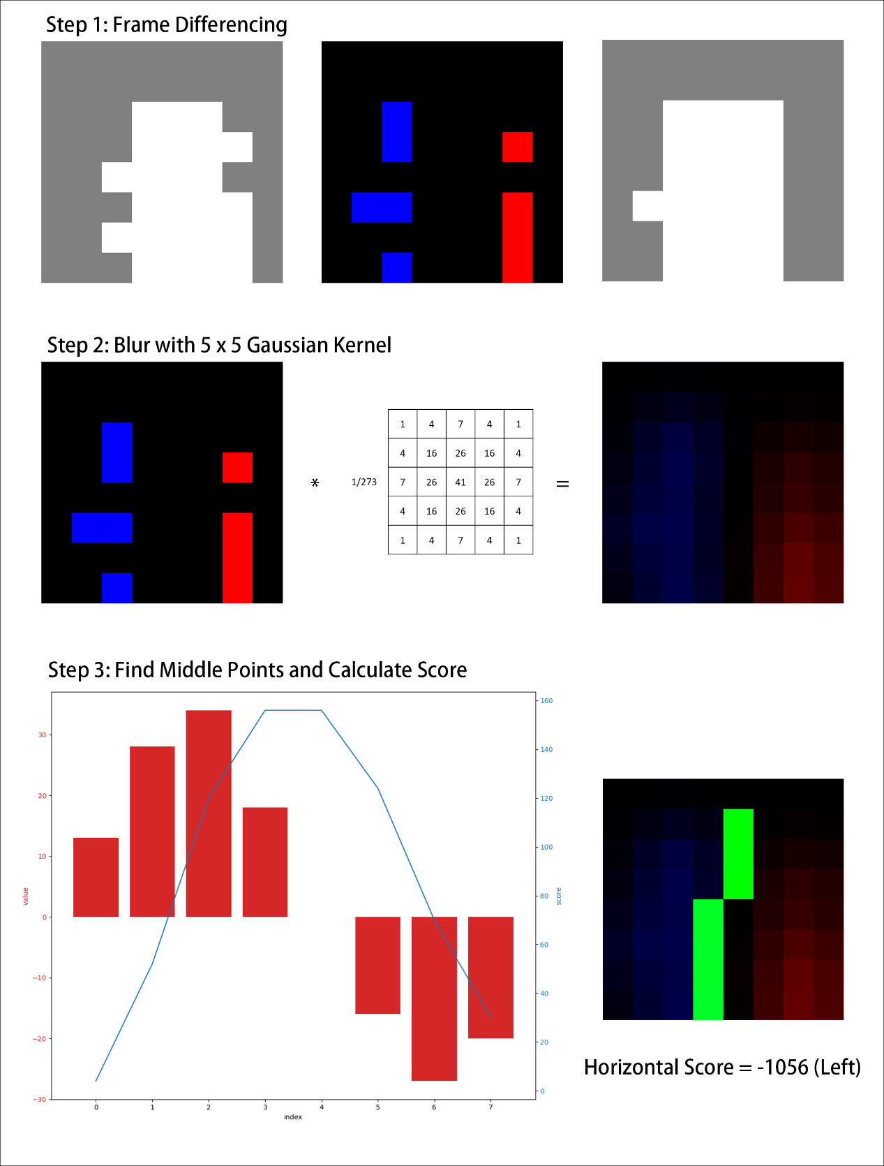
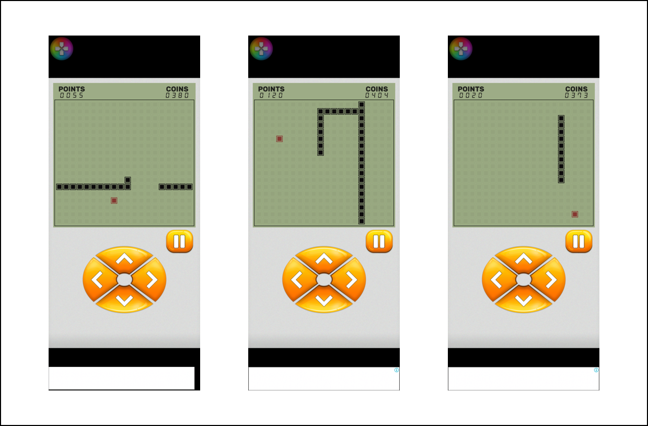
4.1 Gesture Set I: Swipe + Push/Pull

Slide 33
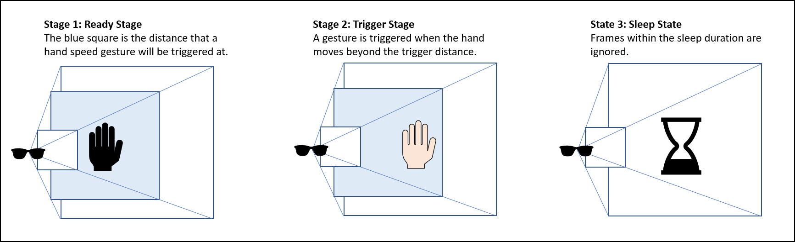
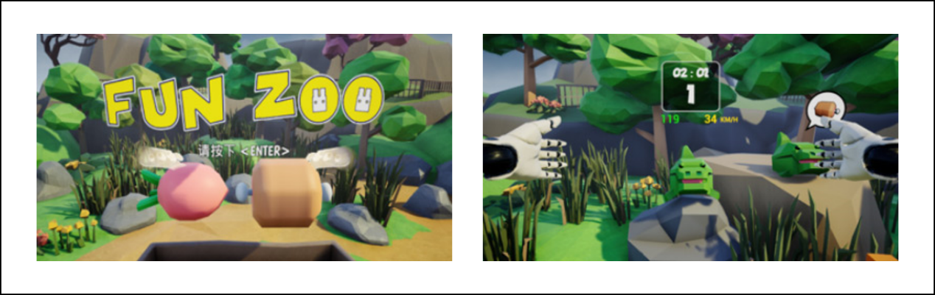
4.2 Gesture Set II: Hand Speed

Slide 34
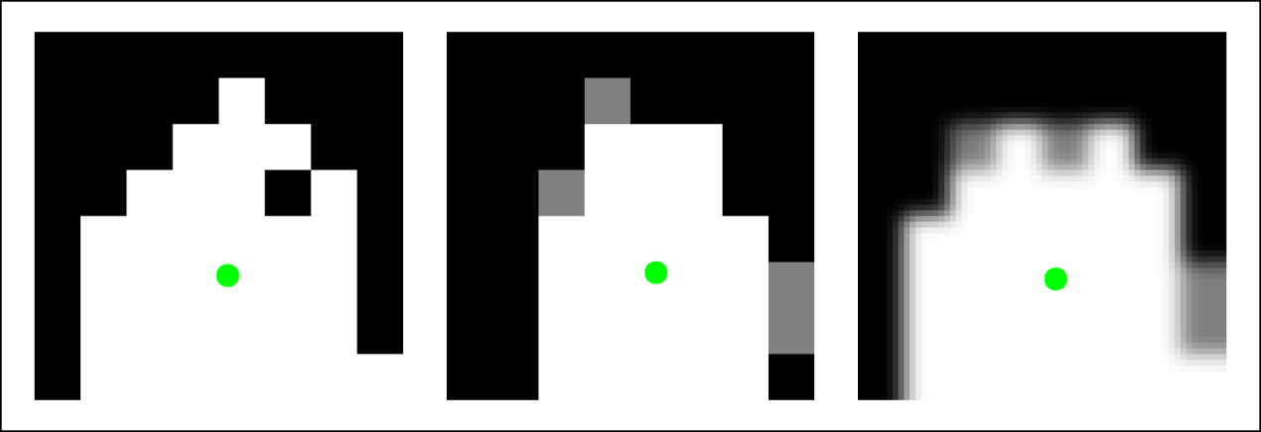
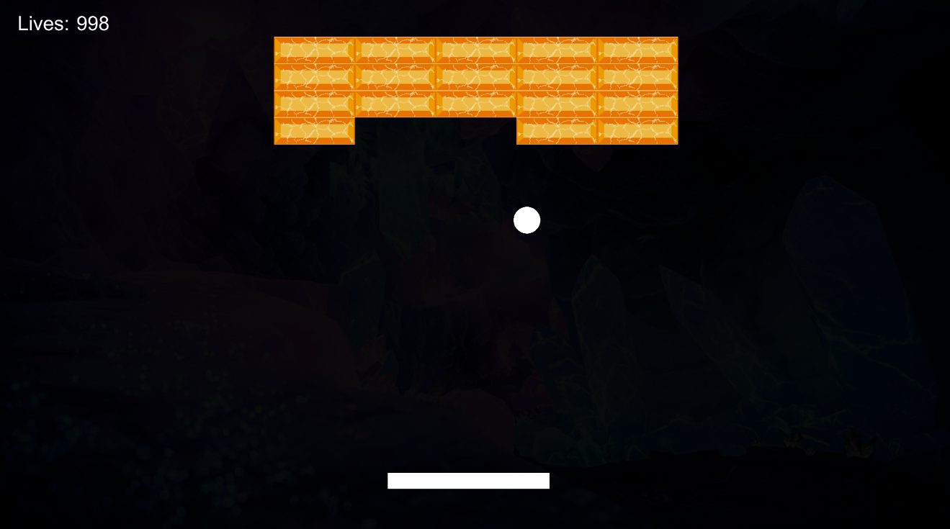
4.3 Gesture Set III: Hand Tracking

Slide 35
References

Slide 36
[1] N. Ahmad, R. A. R. Ghazilla, N. M. Khairi, and V. Kasi, “Reviews on Various Inertial Measurement Unit (IMU) Sensor Applications,” International Journal of Signal Processing Systems, Vol. 1, No. 2, pp. 256-262, 2013.
[2] R. Aigner, D. Wigdor, H. Benko, M. Haller, D. Lindbauer, A. Ion, ... and J. T. K. V. Koh, “Understanding Mid-Air Hand Gestures: A Study of Human Preferences in Usage of Gesture Types for HCI,” Microsoft Research TechReport MSR-TR-2012-111, 2, 30, 2012.
[3] R. E. Bailey, J. J. Arthur III, and S. P. Williams, “Latency Requirements for Head-Worn Display S/EVS Applications,” SPIE Enhanced and Synthetic Vision, Vol. 5424, pp. 98-109, 2004.
[4] T. Bailey and H. Durrant-Whyte, “Simultaneous Localization and Mapping (SLAM): Part II,” IEEE Robotics and Automation Magazine, Vol. 13, No. 3, pp. 108-117, 2006.
[5] S. Beauregard, “A Helmet-Mounted Pedestrian Dead Reckoning System,” Proceedings of International Forum on Applied Wearable Computing, Bremen, Germany, pp. 1-11, 2006.
[6] S. Beauregard and H. Haas, “Pedestrian Dead Reckoning: A Basis for Personal Positioning,” Proceedings of Workshop on Positioning, Navigation and
Communication, Hannover, Germany, pp. 27-35, 2006.
[7] J. D. N. Dionisio, W. G. Burns III, and R. Gilbert, “3D Virtual Worlds and the Metaverse: Current Status and Future Possibilities,” ACM Computing Surveys, Vol. 45, No. 3, pp. 1-38, 2013. [8] Epson, “Moverio BT-30C,” https://www.epson.com.tw/, 2022. [9] Fun2, “FunZoo,” https://fun2studio.com/game_FunZoo.html, 2022.
[10] L. C. Hale, “Principles and Techniques for Designing Precision Machines,” Ph. D. Thesis, Department of Mechanical Engineering, MIT, 1999.

Slide 37
[11] K. Holmqvist, M. Nyström, R. Andersson, R. Dewhurst, H. Jarodzka, and J. Van de Weijer, Eye Tracking: A Comprehensive Guide to Methods and Measures, Oxford University Press, Oxford, UK, 2011. [12] Jorjin, “Jorjin J-Reality J7EF Plus,” https://www.jorjin.com/products/ar-smart-glasses/j-reality/j7ef-plus/, 2022.
[13] K. Kiyokawa, “Trends and Vision of Head Mounted Display in Augmented Reality,” Proceedings of International Symposium on Ubiquitous Virtual Reality, Daejeon, Korea, pp. 14-17, 2012.
[14] K. Kiyokawa, M. Billinghurst, B. Campbell, and E. Woods, “An Occlusion Capable Optical See-through Head Mount Display for Supporting Co-located Collaboration,” Proceedings of IEEE and ACM International Symposium on
Mixed and Augmented Reality, Tokyo, Japan, pp. 133-141, 2003.
[15] M. Lambooij, M. Fortuin, I. Heynderickx, and W. IJsselsteijn, “Visual Discomfort and Visual Fatigue of Stereoscopic Displays: A Review,” Journal of Imaging Science and Technology, Vol. 53, No. 3, pp. 30201-1-14, 2009.
[16] L. H. Lee and P. Hui, “Interaction Methods for Smart Glasses: A Survey,” IEEE Access, Vol. 6, pp. 28712-28732, 2018.
[17] H. Leppäkoski, J. Collin, and J. Takala, “Pedestrian Navigation Based on Inertial Sensors, Indoor Map, and WLAN Signals,” Journal of Signal Processing Systems, Vol. 71, No. 3, pp. 287-296, 2013.
[18] S. Li, C. Xu, and M. Xie, “A Robust O(n) Solution to the Perspective-N-Point Problem,” IEEE Transactions on Pattern Analysis and Machine Intelligence, Vol. 34, No. 7, pp. 1444-1450, 2012.
[19] S. Liu, D. Cheng, and H. Hua, “An Optical See-through Head Mounted Display with Addressable Focal Planes,” Proceedings of IEEE/ACM International Symposium on Mixed and Augmented Reality, Cambridge, UK, pp. 33-42, 2008.
[20] Microsoft, “Microsoft HoloLens 2,” https://www.microsoft.com/en-us/hololens/hardware, 2022.

Slide 38
[21] P. Milgram and F. Kishino, “A Taxonomy of Mixed Reality Visual Displays,” IEICE Transactions on Information and Systems, Vol. 77, No. 12, pp. 1321-1329,
1994.
[22] Peaksel Games, “Snake Game,” https://play.google.com/store/apps/details?id=com.snakegame.freesnakegames, 2022.
[23] F. Remondino and D. Stoppa, Eds., TOF Range-Imaging Cameras, Vol. 68121, Springer, Heidelberg, Germany, 2013.
[24] J. L. Schonberger and J. M. Frahm, “Structure-from-Motion Revisited,” Proceedings of the IEEE Conference on Computer Vision and Pattern Recognition, Las Vegas, NV, pp. 4104-4113, 2016.
[25] ST, “ST VL53L5CV Datasheet,” https://www.st.com/resource/en/datasheet/vl53l5cx.pdf, 2022.
[26] A. R. Vidal, H. Rebecq, T. Horstschaefer, and D. Scaramuzza, “Ultimate SLAM? Combining Events, Images, and IMU for Robust Visual SLAM in HDR and High-Speed Scenarios,” IEEE Robotics and Automation Letters, Vol. 3, No. 2, pp. 994-1001, 2018.
[27] Y. Wu, F. Tang, and H. Li, “Image-Based Camera Localization: An Overview,” Visual Computing for Industry, Biomedicine, and Art, Vol. 1, No. 1, pp. 1-13, 2018.

